Slide 1

Big Data Infrastructure
CS 489/698 Big Data Infrastructure (Winter 2017)
Week 1: Introduction (1/2)
January 3, 2017
Jimmy Lin
David R. Cheriton School of Computer Science
University of Waterloo
These slides are available at http://lintool.github.io/bigdata-2017w/
This work is licensed under a Creative Commons Attribution-Noncommercial-Share Alike 3.0 United States See http://creativecommons.org/licenses/by-nc-sa/3.0/us/ for details

Slide 2
Questions for Today
Who am I?
What is big data?
Why big data?
What is this course about?

Slide 3
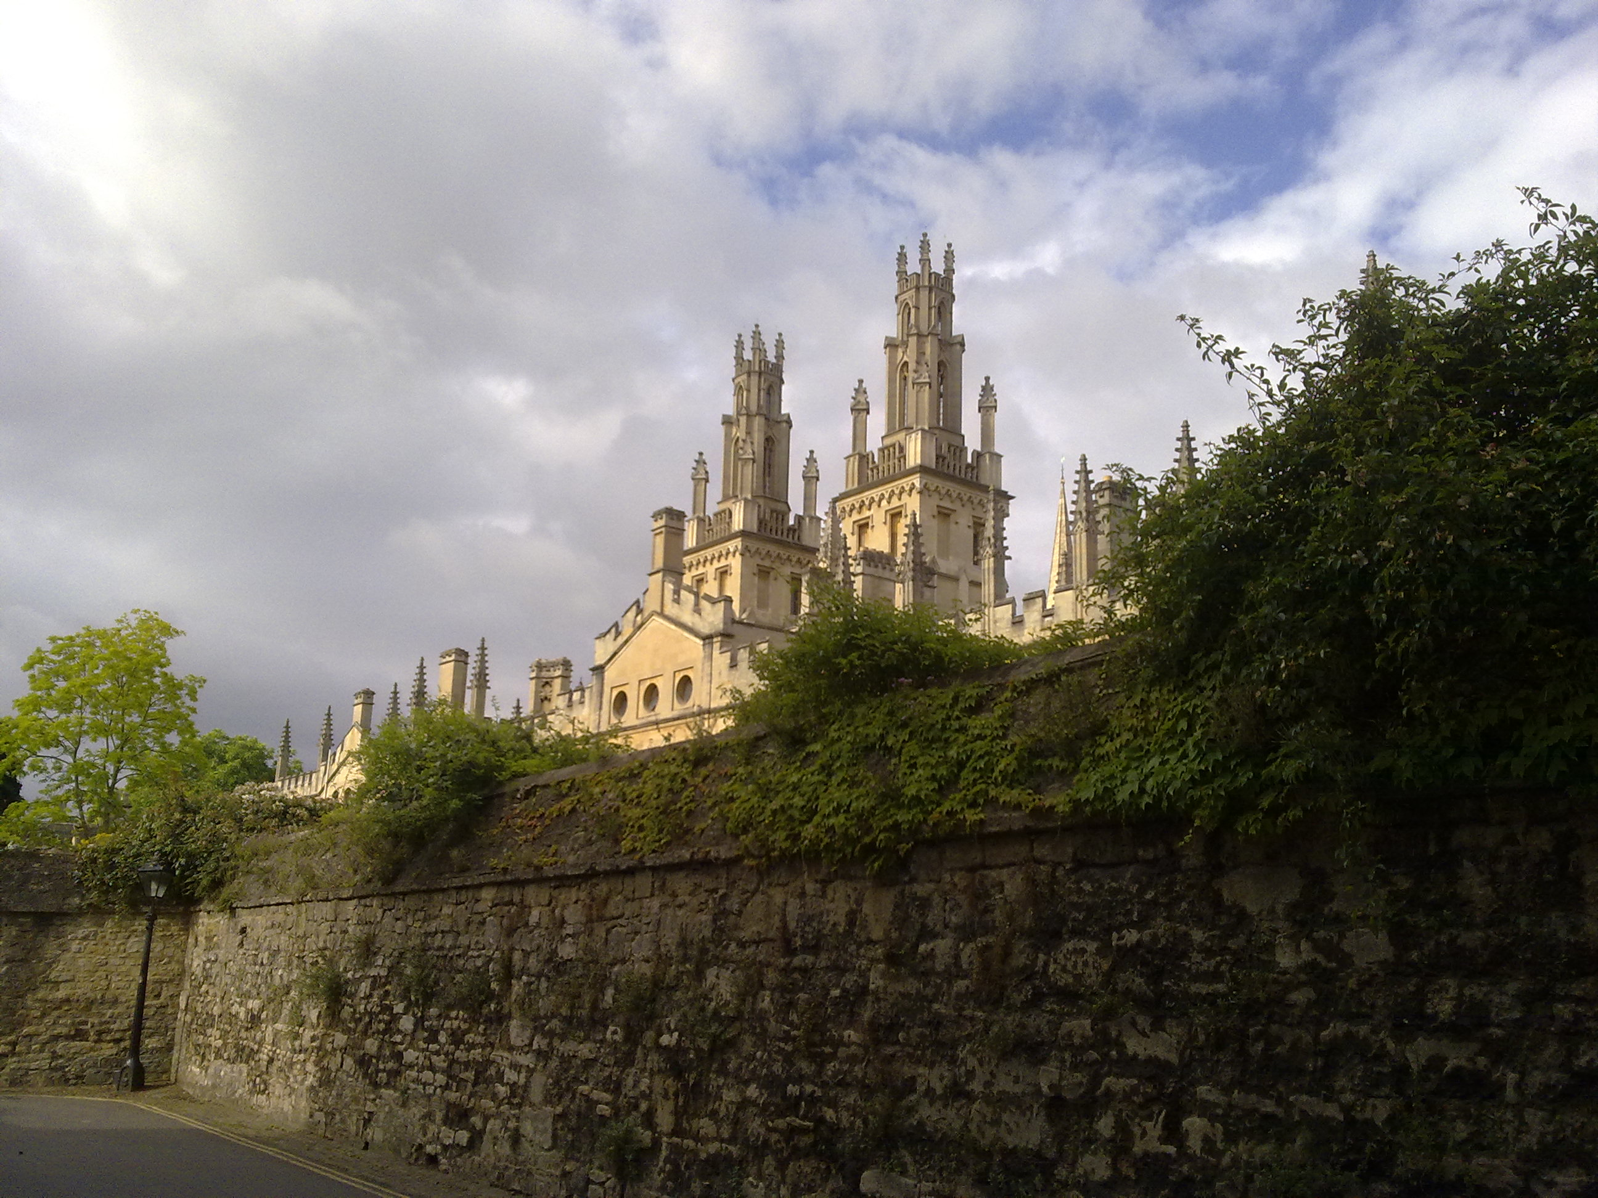





From the Ivory Tower…
Source: Wikipedia (All Souls College, Oxford)

Slide 4
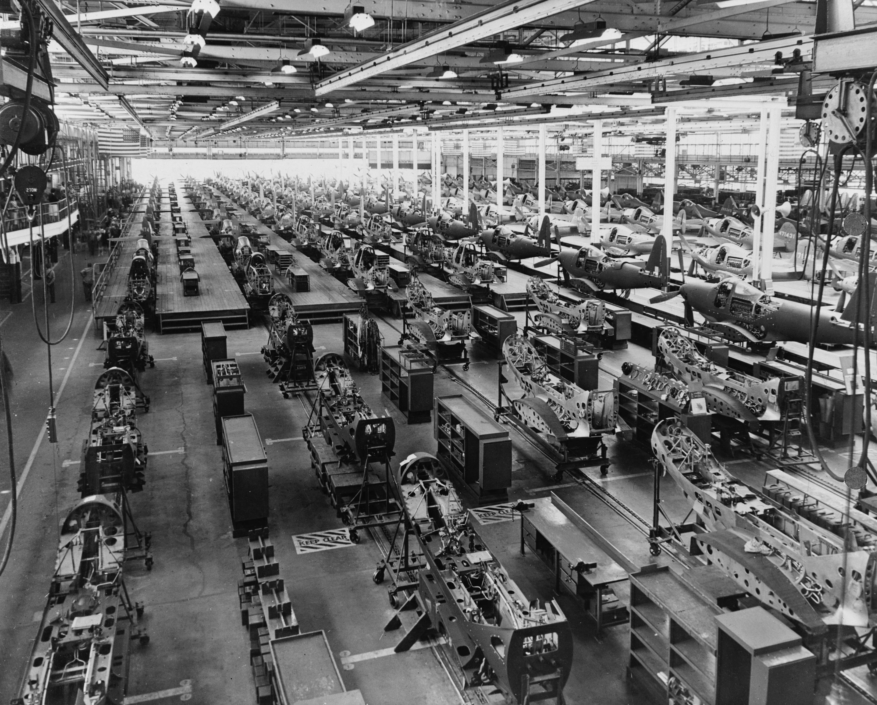
… to building sh*t that works
Source: Wikipedia (Factory)

Slide 5

… and back!
Source: Wikipedia (All Souls College, Oxford)

Slide 6
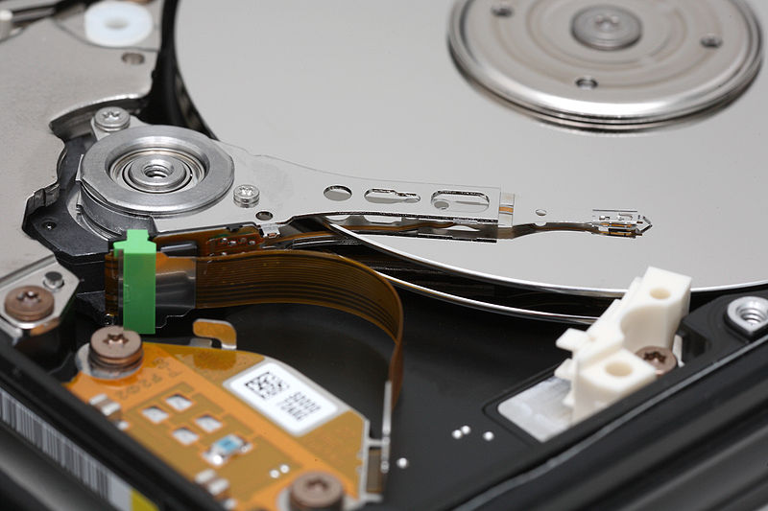
Big Data
Source: Wikipedia (Hard disk drive)

Slide 7








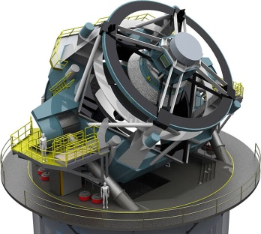


Processes 20 PB a day (2008)
Crawls 20B web pages a day (2012)
Search index is 100+ PB (5/2014)
Bigtable serves 2+ EB, 600M QPS (5/2014)
400B pages, 10+ PB (2/2014)
19 Hadoop clusters: 600 PB, 40k servers (9/2015)
Hadoop: 10K nodes, 150K cores, 150 PB (4/2014)
150 PB on 50k+ servers running 15k apps (6/2011)
300 PB data in Hive + 600 TB/day (4/2014)
LHC: ~15 PB a year
S3: 2T objects, 1.1M request/second (4/2013)
640K ought to be enough for anybody.
LSST: 6-10 PB a year (~2020)
SKA: 0.3 – 1.5 EB per year (~2020)
How much data?

Slide 8

Why big data?
Science
Engineering
Commerce
Society
Source: Wikipedia (Everest)

Slide 9
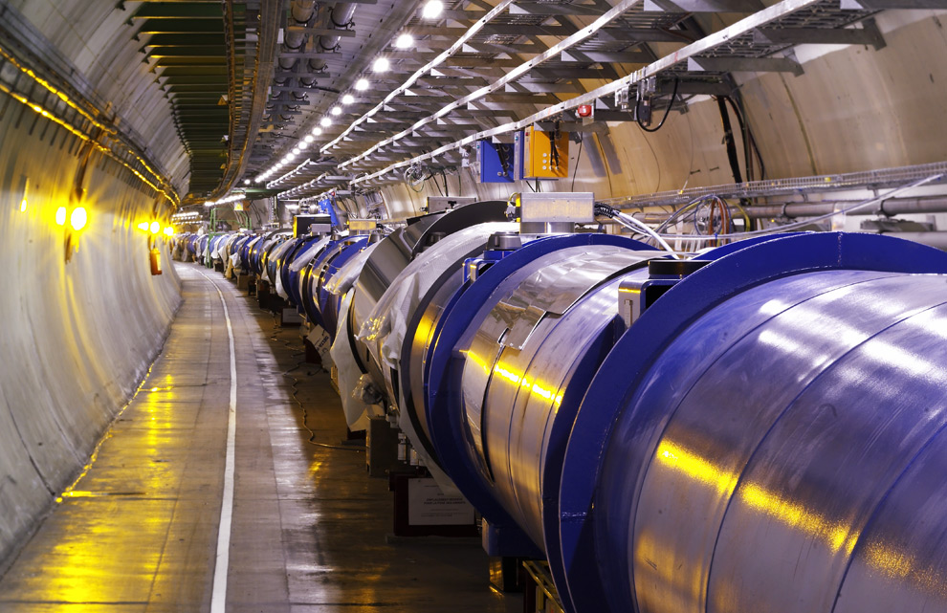
Science
Emergence of the 4th Paradigm
Data-intensive e-Science
Maximilien Brice, © CERN
Notes:
By the time it shuts down in 2011, the CERN collider should have amassed about 20 times as much data as it now has. (NYTimes article, “Trillions of Reasons to Be Excited”, 11/1/2010)

Slide 10
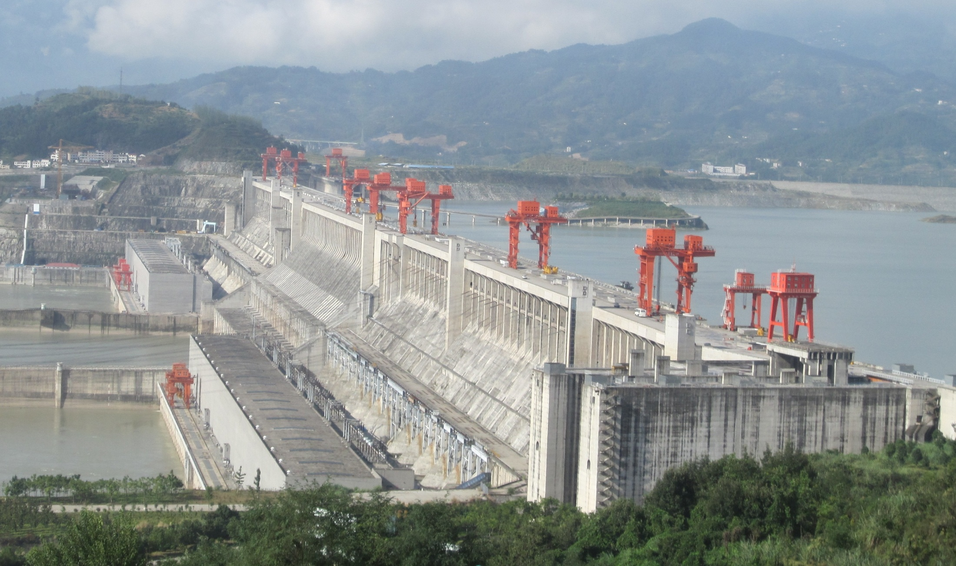
Engineering
The unreasonable effectiveness of data
Search, recommendation, prediction, …
Source: Wikipedia (Three Gorges Dam)

Slide 11

Commerce
Know thy customers
Data → Insights → Profit!
Source: Wikiedia (Shinjuku, Tokyo)

Slide 12
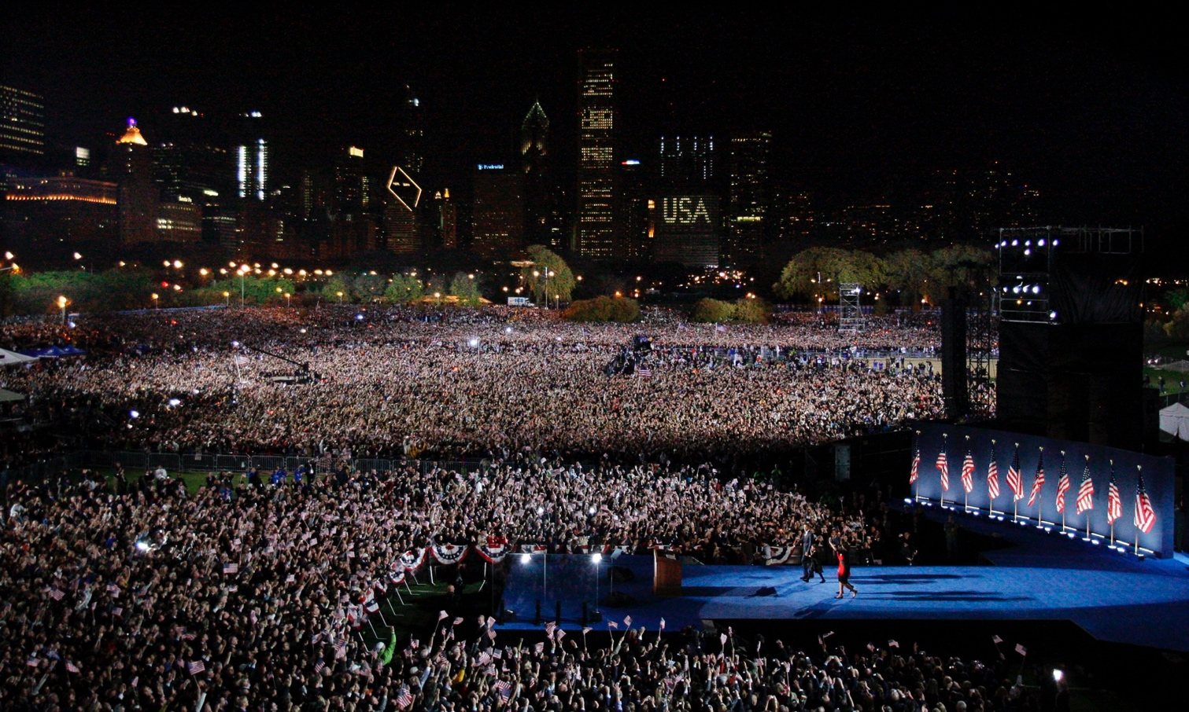
Society
Humans as social sensors
Computational social science
Source: Guardian

Slide 13
What is this course about?
Data Science
Tools
This Course
Analytics Infrastructure
Execution Infrastructure
“big data stack”

Slide 14
Buzzwords
Text: frequency estimation, language models, inverted indexes
Graphs: graph traversals, random walks (PageRank)
Relational data: SQL, joins, column stores
Data mining: hashing, clustering (k-means), classification, recommendations
Streams: probabilistic data structures (Bloom filters, CMS, HLL counters)
data analytics, business intelligence, OLAP, ETL, data warehouses and data lakes
Data Science
Tools
This Course
Analytics Infrastructure
MapReduce, Spark, noSQL, Flink, Pig, Hive, Dryad, Pregel, Giraph, Storm
Execution Infrastructure
“big data stack”
This course focuses on algorithm design and “thinking at scale”

Slide 15
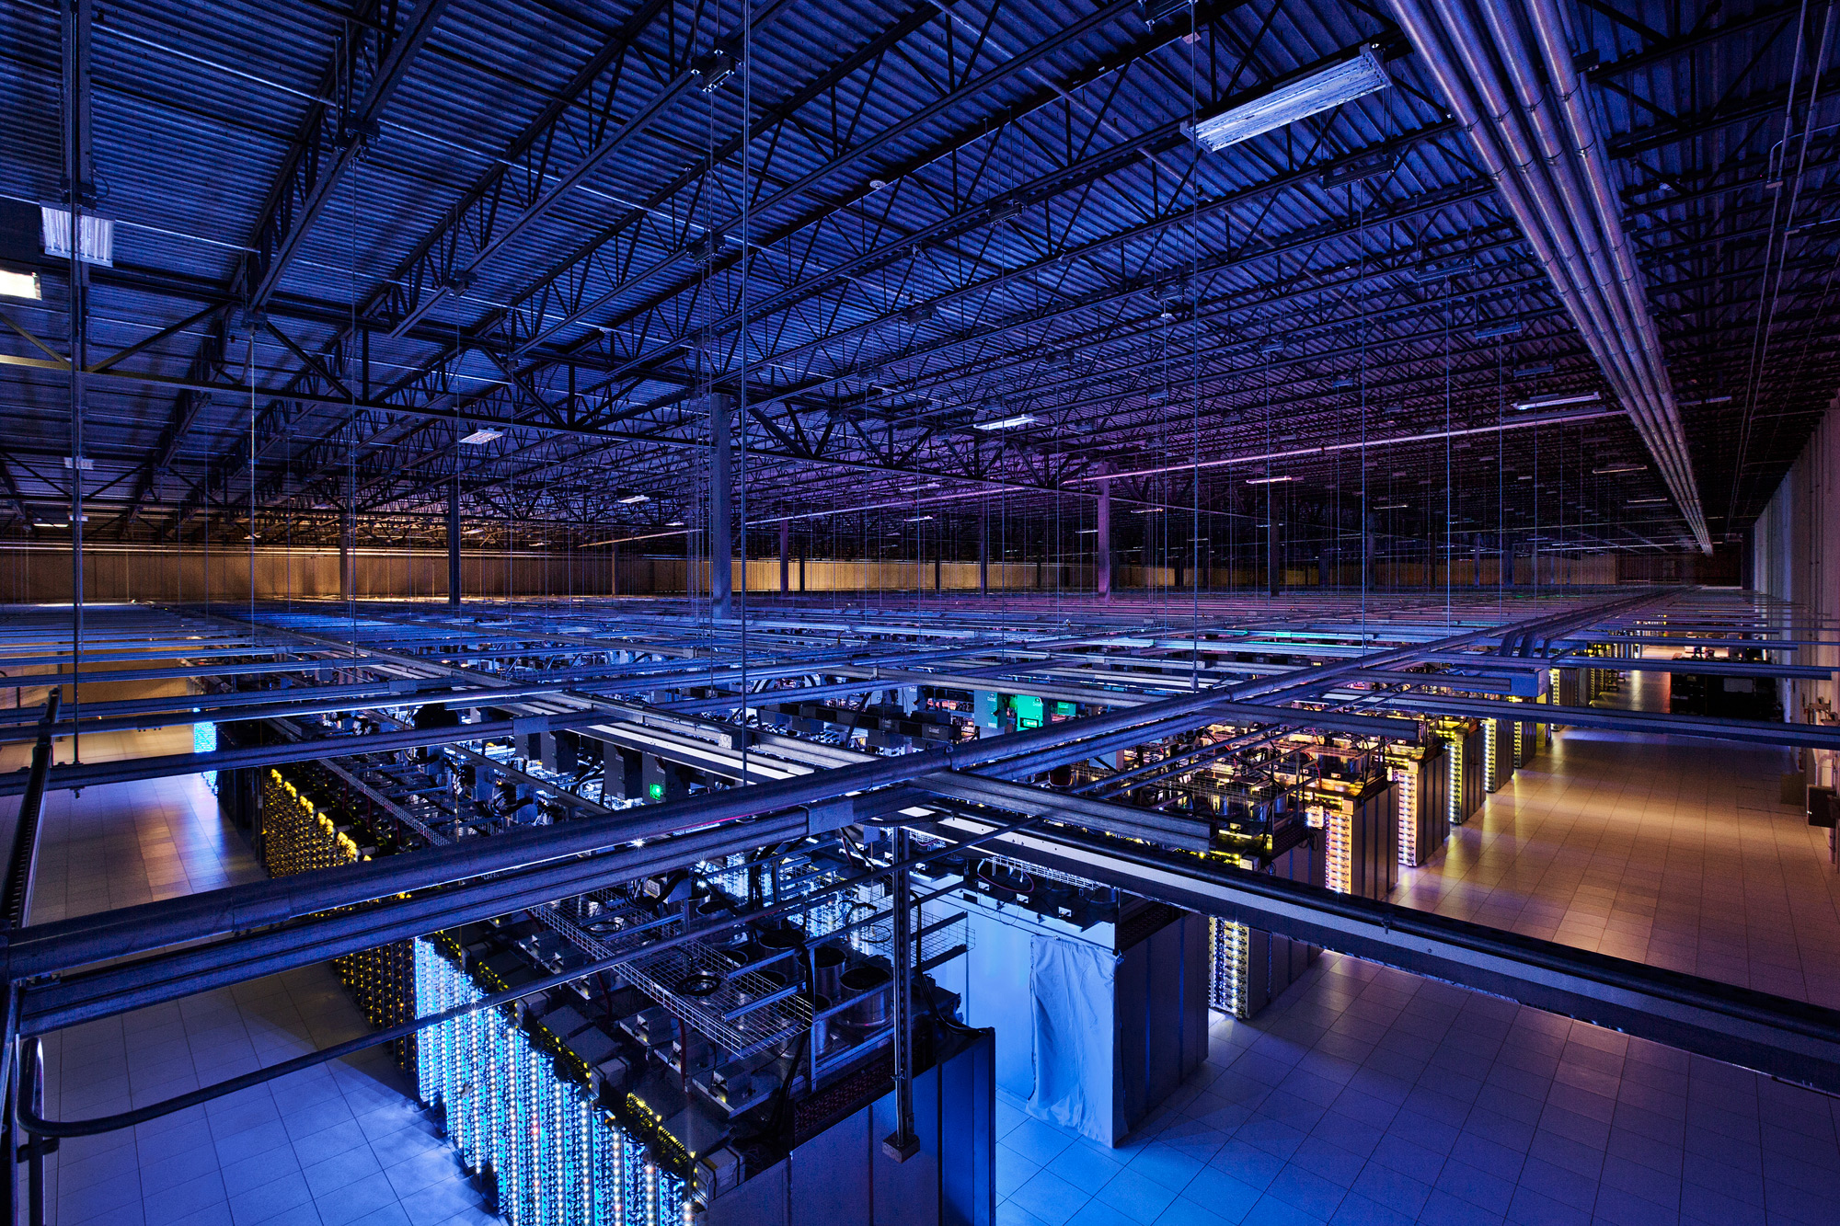
Tackling Big Data
Source: Google

Slide 16
Divide and Conquer
“Work”
Partition
w₁
w₂
w₃
worker
worker
worker
r₁
r₂
r₃
Combine
“Result”

Slide 17
Parallelization Challenges
How do we assign work units to workers?
What if we have more work units than workers?
What if workers need to share partial results?
How do we aggregate partial results?
How do we know when all the workers have finished?
What if workers die?
Difficult because:
We don’t know the order in which workers run…
We don’t know when workers interrupt each other…
We don’t know when workers need to communicate partial results…
We don’t know the order in which workers access shared resources…
What’s the common theme of all of these problems?

Slide 18
Common Theme?
Parallelization problems arise from:
Communication between workers (e.g., to exchange state)
Access to shared resources (e.g., data)
How do we tackle these challenges?

Slide 19
Current Tools
Basic primitives
Semaphores (lock, unlock)
Conditional variables (wait, notify, broadcast)
Barriers
Awareness of Common Problems
Deadlock, livelock, race conditions...
Dining philosophers, sleeping barbers, cigarette smokers...

Slide 20
Current Tools
Programming Models
Shared Memory
Message Passing
Memory
P₁
P₂
P₃
P₄
P₅
P₁
P₂
P₃
P₄
P₅
Design Patterns
producer
consumer
master
work queue
slaves
producer
consumer

Slide 21
When Theory Meets Practices
Concurrency is already difficult to reason about…
Now throw in:
At the scale of datacenters and across datacenters
In the presence of failures
In the presence of multiple interacting services
The reality:
Lots of one-off solutions, custom code
Write you own dedicated library, then program with it
Burden on the programmer to explicitly manage everything
Bottom line: it’s hard!

Slide 22
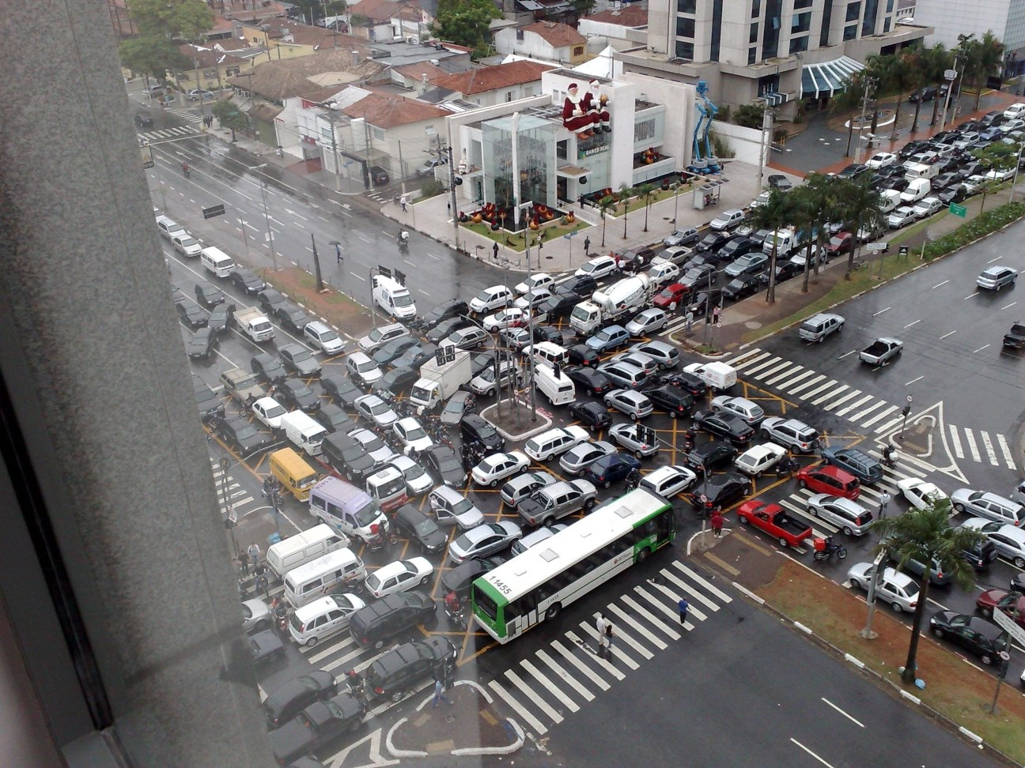
Source: Ricardo Guimarães Herrmann

Slide 23
Source: CS 251

Slide 24
✗
Source: CS 251

Slide 25
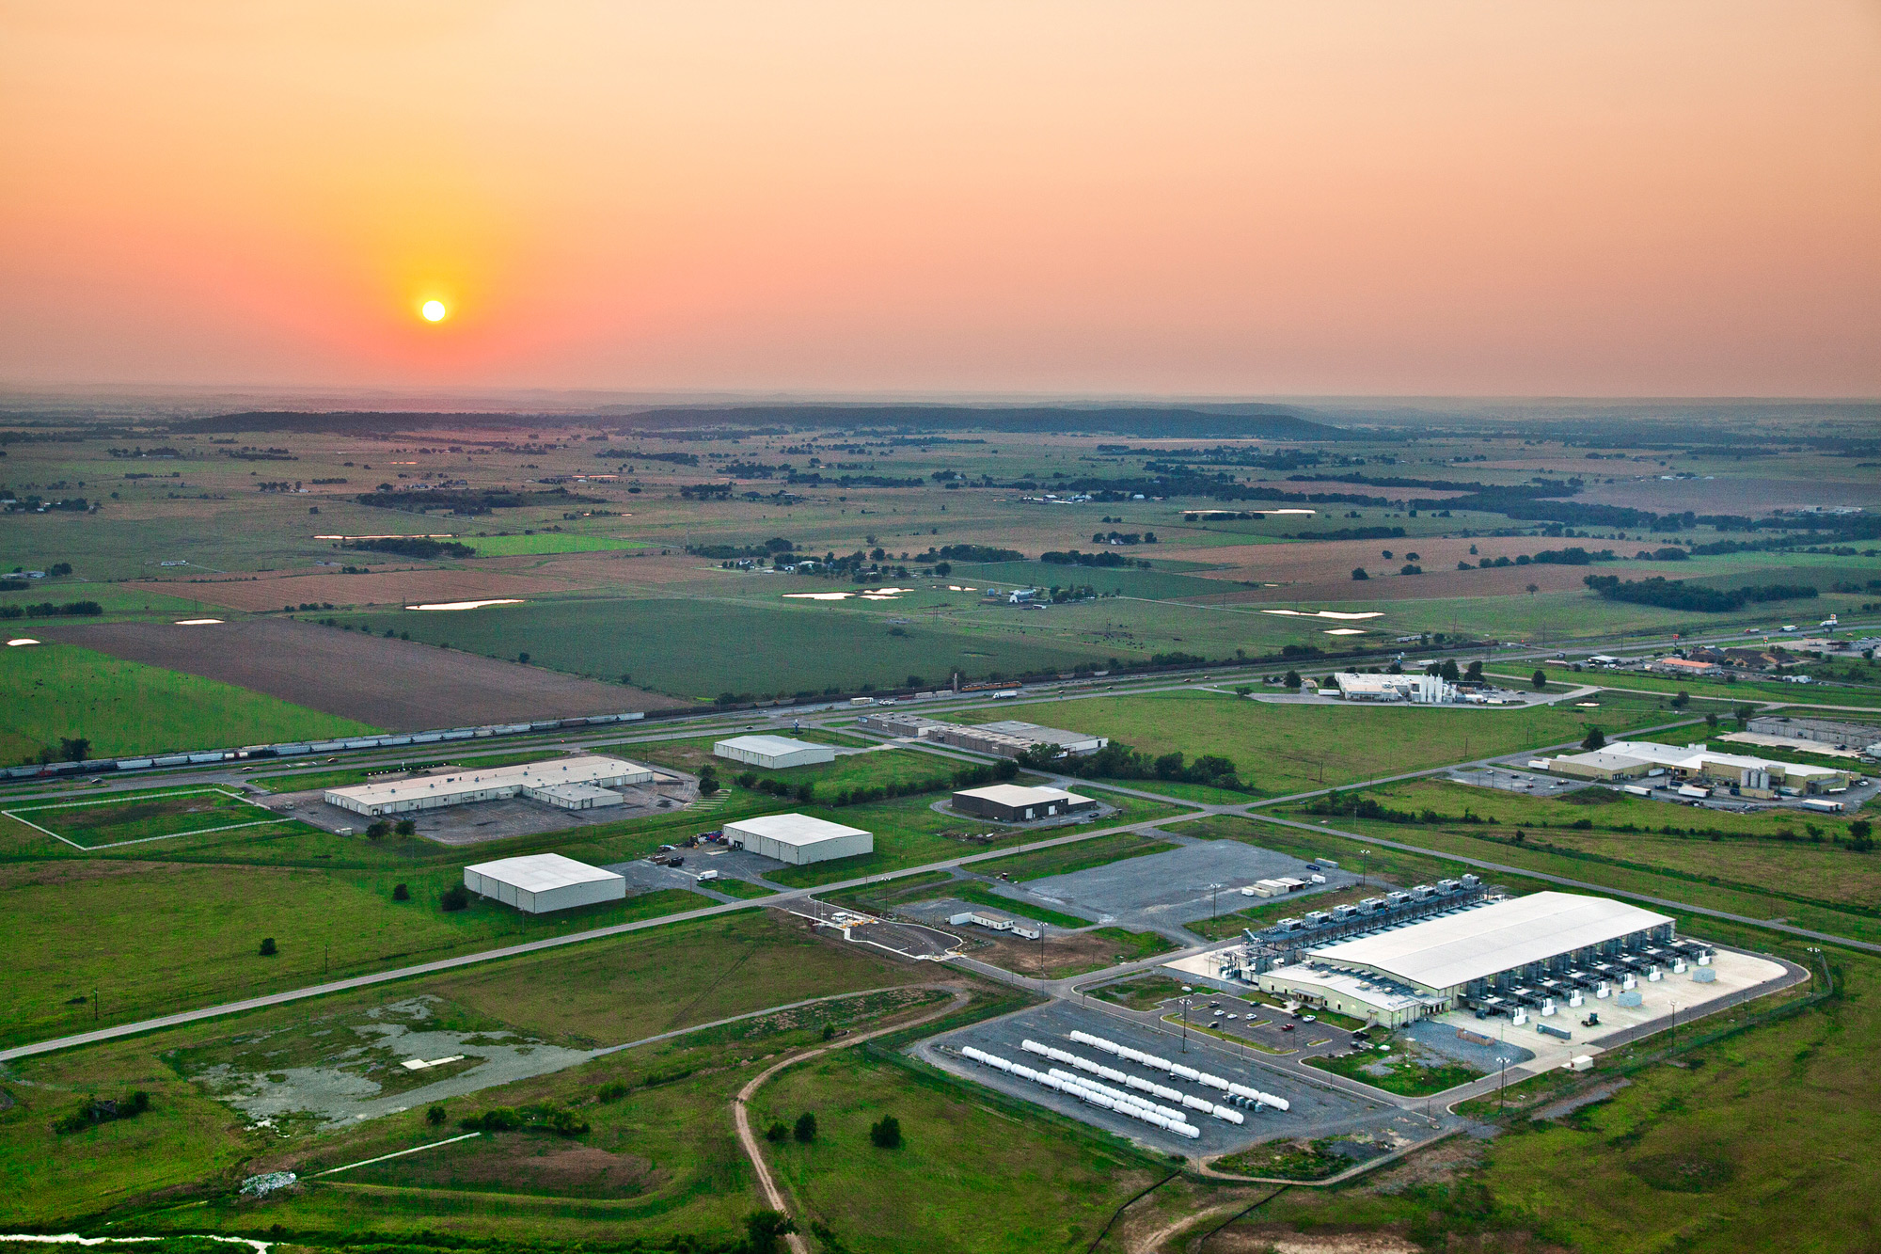
The datacenter is the computer!
Source: Google

Slide 26
The datacenter is the computer!
It’s all about the right level of abstraction
Moving beyond the von Neumann architecture
What’s the “instruction set” of the datacenter computer?
Hide system-level details from the developers
No more race conditions, lock contention, etc.
No need to explicitly worry about reliability, fault tolerance, etc.
Separating the what from the how
Developer specifies the computation that needs to be performed
Execution framework (“runtime”) handles actual execution
MapReduce is the first instantiation of this idea… but not the last!

Slide 27
MapReduce
Source: Google

Slide 28
Typical Big Data Problem
Iterate over a large number of records
Map
Extract something of interest from each
Shuffle and sort intermediate results
Aggregate intermediate results
Reduce
Generate final output
Key idea: provide a functional abstraction for these two operations

Slide 29
Roots in Functional Programming
Map
f
f
f
f
f
Fold
g
g
g
g
g

Slide 30
Functional Programming in Scala
scala> val t = Array(1, 2, 3, 4, 5)
t: Array[Int] = Array(1, 2, 3, 4, 5)
scala> t.map(n => n*n)
res0: Array[Int] = Array(1, 4, 9, 16, 25)
scala> t.map(n => n*n).foldLeft(0)((m, n) => m + n)
res1: Int = 55
MapReduce = Functional programming + distributed computing!

Slide 31
MapReduce
Programmer specifies two functions:
map (k₁, v₁) → [<k₂, v₂>]
reduce (k₂, [v₂]) → [<k₃, v₃>]
All values with the same key are sent to the same reducer
The execution framework handles everything else…

Slide 32
k₁
v₁
k₂
v₂
k₃
v₃
k₄
v₄
k₅
v₅
k₆
v₆
map
map
map
map
a
1
b
2
c
3
c
6
a
5
c
2
b
7
c
8
Shuffle and Sort: aggregate values by keys
a
1
5
b
2
7
c
2
3
6
8
reduce
reduce
reduce
r₁
s₁
r₂
s₂
r₃
s₃

Slide 33
MapReduce
Programmer specifies two functions:
map (k₁, v₁) → [<k₂, v₂>]
reduce (k₂, [v₂]) → [<k₃, v₃>]
All values with the same key are sent to the same reducer
The execution framework handles everything else…
What’s “everything else”?

Slide 34
MapReduce “Runtime”
Handles scheduling
Assigns workers to map and reduce tasks
Handles “data distribution”
Moves processes to data
Handles synchronization
Gathers, sorts, and shuffles intermediate data
Handles errors and faults
Detects worker failures and restarts
Everything happens on top of a distributed FS (later)

Slide 35
MapReduce
Programmer specifies two functions:
map (k₁, v₁) → [<k₂, v₂>]
reduce (k₂, [v₂]) → [<k₃, v₃>]
All values with the same key are sent to the same reducer
The execution framework handles everything else…
Not quite…

Slide 36
MapReduce
four
✗
Programmer specifies two functions:
map (k₁, v₁) → [<k₂, v₂>]
reduce (k₂, [v₂]) → [<k₃, v₃>]
All values with the same key are sent to the same reducer
partition (k', p) → 0 ... p-1
Often a simple hash of the key, e.g., hash(k') mod n
Divides up key space for parallel reduce operations
combine (k', v') → <k', v'>*
Mini-reducers that run in memory after the map phase
Used as an optimization to reduce network traffic

Slide 37
k₁
v₁
k₂
v₂
k₃
v₃
k₄
v₄
k₅
v₅
k₆
v₆
map
map
map
map
a
1
b
2
c
3
c
6
a
5
c
2
b
7
c
8
combine
combine
combine
combine
a
1
b
2
c
9
a
5
c
2
b
7
c
8
partition
partition
partition
partition
Shuffle and Sort: aggregate values by keys
a
1
5
b
2
7
c
c
2
2
9
3
8
6
8
reduce
reduce
reduce
r₁
s₁
r₂
s₂
r₃
s₃

Slide 38
Two More Details…
Barrier between map and reduce phases
But runtime can begin copying intermediate data earlier
Keys arrive at each reducer in sorted order
No enforced ordering across reducers

Slide 39
“Hello World” MapReduce: Word Count
map(string docid, string text):
for each word w in text:
Emit(w, 1);
reduce(string term, iterator<int> values):
int sum = 0;
for each v in values:
sum += v;
emit(term, sum);

Slide 40
MapReduce can refer to…
The programming model
The execution framework (aka “runtime”)
The specific implementation
Usage is usually clear from context!

Slide 41

MapReduce Implementations
Google has a proprietary implementation in C++
Bindings in Java, Python
Hadoop provides an open-source implementation in Java
Development begun by Yahoo, later an Apache project
Used in production at Facebook, Twitter, LinkedIn, Netflix, …
Large and expanding software ecosystem
Potential point of confusion: Hadoop is more than MapReduce today
Lots of custom research implementations

Slide 42
User Program
(1) submit
Master
(2) schedule map
(2) schedule reduce
worker
split 0
(6) write
output
file 0
split 1
(5) remote read
worker
split 2
(3) read
(4) local write
split 3
worker
split 4
worker
output
file 1
worker
Input
files
Map
phase
Intermediate files
(on local disk)
Reduce
phase
Output
files
We’ll discuss physical execution in detail later…
Adapted from (Dean and Ghemawat, OSDI 2004)

Slide 43

Course Administrivia
Source: http://www.flickr.com/photos/artmind_etcetera/6336693594/

Slide 44
My Expectations
Your background:
Pre-reqs: CS 341, CS 350, (CS 348)
Comfortable in Java and Scala
Know how to use Git
Reasonable “command-line”-fu skills
Experience in compiling, patching, and installing open source software
Good debugging skills
Your are:
Genuinely interested in the topic
Be prepared to put in the time
Comfortable with immature software

Slide 45
Important Coordinates
Course website:
http://lintool.github.io/bigdata-2017w/
Lots of info there, read it!
(“I didn’t see it” will not be accepted as an excuse.)
Communicating with us:
Piazza for general questions (link on course homepage)
Personal concerns: uwaterloo-bigdata-2017w-staff@googlegroups.com
(Mailing list reaches me and TAs)
Bespin
http://bespin.io/

Slide 46
Course Design
This course focuses on algorithm design and “thinking at scale”
Not the “mechanics” (API, command-line invocations, et.)
You’re expected to pick up MapReduce/Spark with minimal help
Components of the final grade:
Eight individual assignments
Final exam
CS 698: additional group final project

Slide 47
MapReduce/Spark Environments
See “Software” page in course homepage for instructions
Linux Student CS Environment
Everything is set up for you, just follow instructions
We’ll make sure everything works
Local installations
Install all software components on your own machine
Requires at least 4GB RAM and plenty of disk space
Works fine on Mac and Linux, YMMV on Windows
Important: For your convenience only!
We’ll provide basic instructions, but not technical support
Altiscale: Hadoop-as-a-Service
You’ll be provided an account – watch for the email

Slide 48
Assignment Mechanics
We’ll be using private GitHub repos for assignments
Complete your assignments, push to GitHub
We’ll pull your repos at the deadline and grade
Note late policy (details on course homepage)
Late by up to 24 hours: 25% reduction in grade
Late 24-48 hours: 50% reduction in grade
Late by more the 48 hours: not accepted
By assumption, we’ll pull and mark at deadline: If you want us to hold off, you must let us know!
Important: Register for (free) GitHub educational account!
https://education.github.com/discount_requests/new

Slide 49
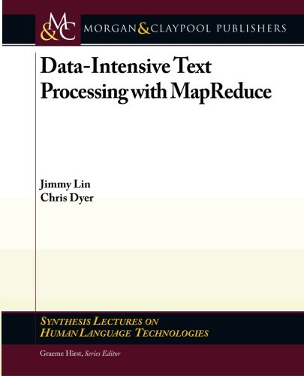
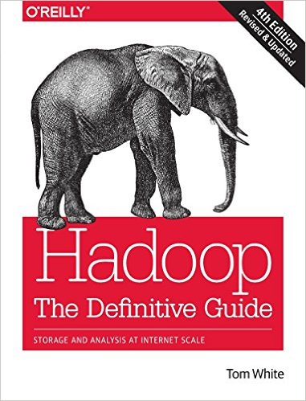

Course Materials
One (required) textbook +
Two (optional but recommended) books +
Additional readings from research papers as appropriate
Note: 4th Edition
(optional but recommended)

Slide 50
If you’re not (yet) registered…

Slide 51

If you’re not (yet) registered…
There’s (some) hope!

Slide 52
If you’re not (yet) registered:
Come and find me after class for the wait list
Continue coming to class, sign in after every class
As spots open up, I’ll give preference to those attending class
Note: late registration is not an excuse for late assignments

Slide 53

Luke: I won’t fail you. I’m not afraid.
Yoda: You will be. You... will... be.

Slide 54

Be prepared…
Source: Wikipedia (The Scream)

Slide 55
“Hadoop Zen”
Parts of the ecosystem are still immature
We’ve come a long way since 2007, but still far to go…
Bugs, undocumented “features”, inexplicable behavior, etc.
Different versions = major pain
Don’t get frustrated (take a deep breath)…
Those W$*#T@F! moments
Be patient…
We will inevitably encounter “situations” along the way
Be flexible…
We will have to be creative in workarounds
Be constructive…
Tell me how I can make everyone’s experience better

Slide 56

“Hadoop Zen”
Source: Wikipedia (Japanese rock garden)

Slide 57
Questions?
To Do:
1. Bookmark course homepage
2. Get on Piazza
3. Register for GitHub educational account
Source: Wikipedia (Japanese rock garden)

